Slide 1
Bookit
A Pair Programming Project

Slide 2
Allow visitors to find books with good ratings in their price range.
Why and how did you make it?

Slide 3
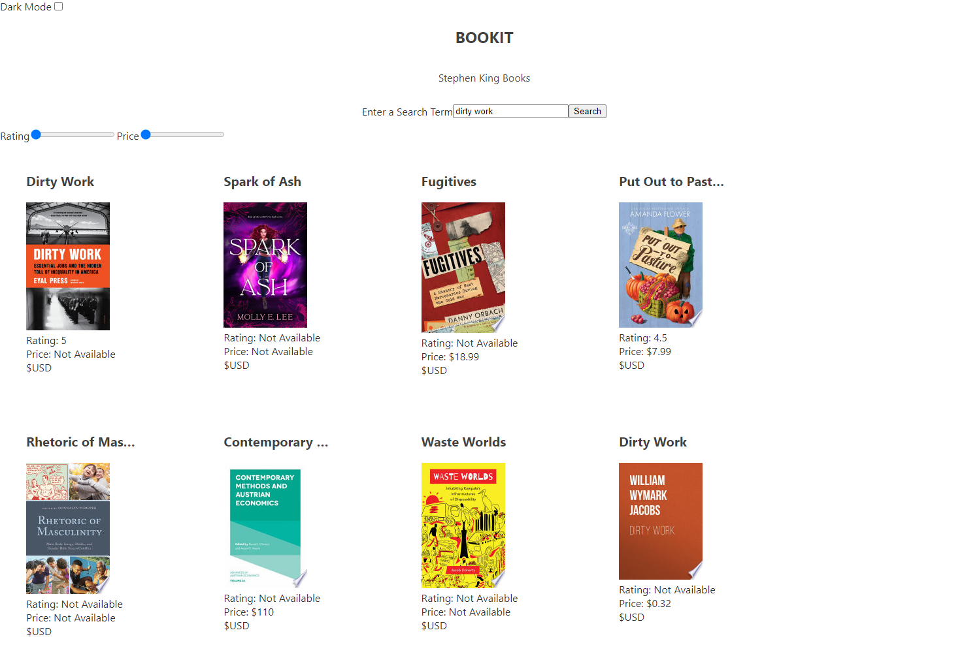
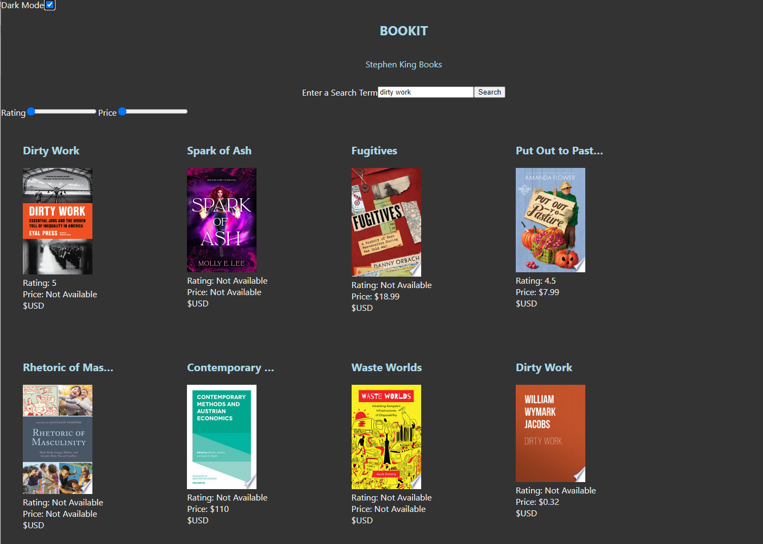
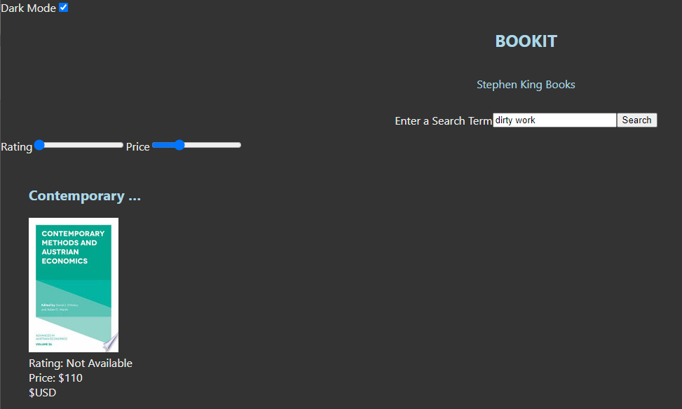
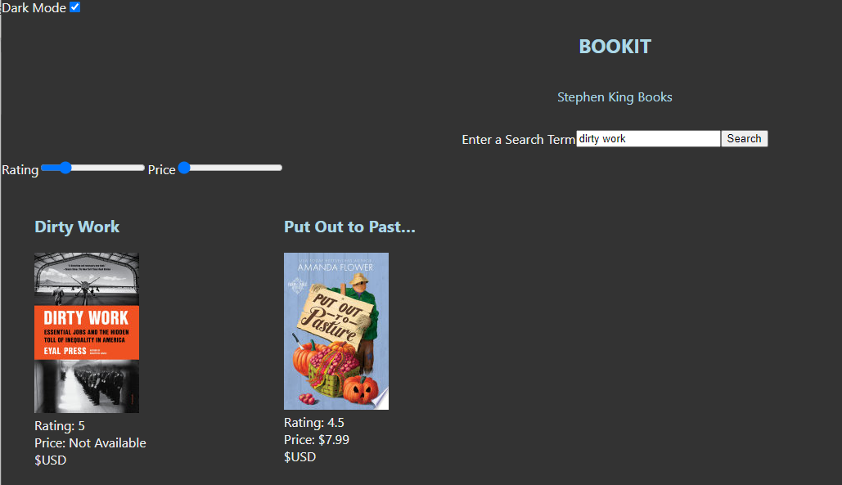
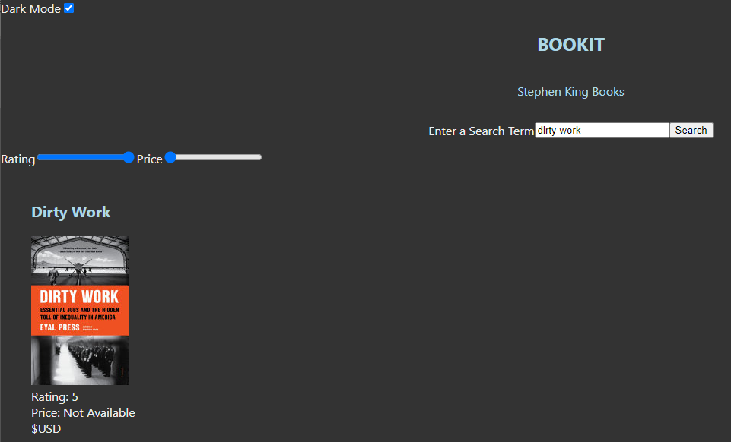
Pair Programming

Slide 4
The Successes
What went well? What did you knock out of the park?
Decision on what to Do
Planning
API
Integration with Google
Backend
Dynamic Filter with Sliders
Frontend

Slide 5
The Challenges
What didn’t go so well? What did you learn as a team?
Time Management
Planning
Finding an API that was reliable and detailed
Backend
Dynamic Layout design based on Dynamic content
Frontend

Slide 6
Pair Programming
3 minute
Demo

Slide 7
Site Load
Clear Search history
Search
Send search string to backend
Return results with
Filter
Slider for price
Slider for rating
rating,
price,
subject,
title,
searchTermInSubject,
author,
link,
description
searchTermInAuthor
Get searchTerm

